Slide 1
Computer Architecture Concepts
Part 9 – Decoder, Demultiplexer and Comparator

Slide 2
Objectives
To understand the function of the following components
Decoder
Demultiplexer
Comparator
To consider how to build these components from basic logic gates

Slide 3
Recap – binary numbers
Decimal | 4 | 2 | 1
0 | 0 | 0 | 0
1 | 0 | 0 | 1
2 | 0 | 1 | 0
3 | 0 | 1 | 1
4 | 1 | 0 | 0
5 | 1 | 0 | 1
6 | 1 | 1 | 0
7 | 1 | 1 | 1
Remember that we can take any decimal number and encode it in binary
The number of bits we have available determines what range we can encode
Note we are only considering unsigned integers again here
Number of bits | Range
1 | 0 – 1
2 | 0 – 3
3 | 0 – 7
4 | 0 – 15
5 | 0 – 31
6 | 0 – 63
7 | 0 – 127
8 | 0 – 255

Slide 4
Decoder
A decoder will change a binary number to pass a signal to one (and only one) of its outputs by decoding that binary signal
For example, if we have a decoder that takes in a 3-bit signal then we know that we can represent the decimal number 0 to 7 using those three binary digits. Therefore, the decoder would need 8 different outputs (one for each number from 0 to 7).

Slide 5
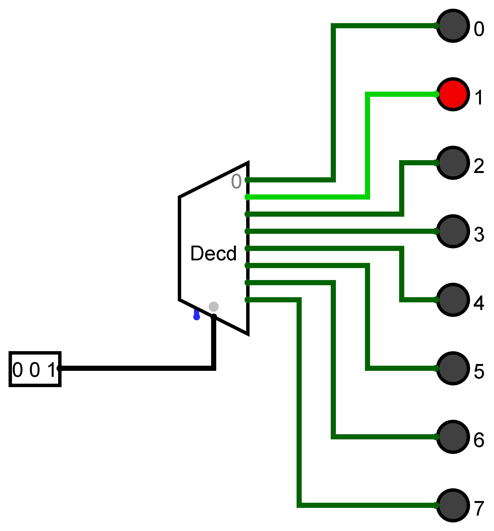
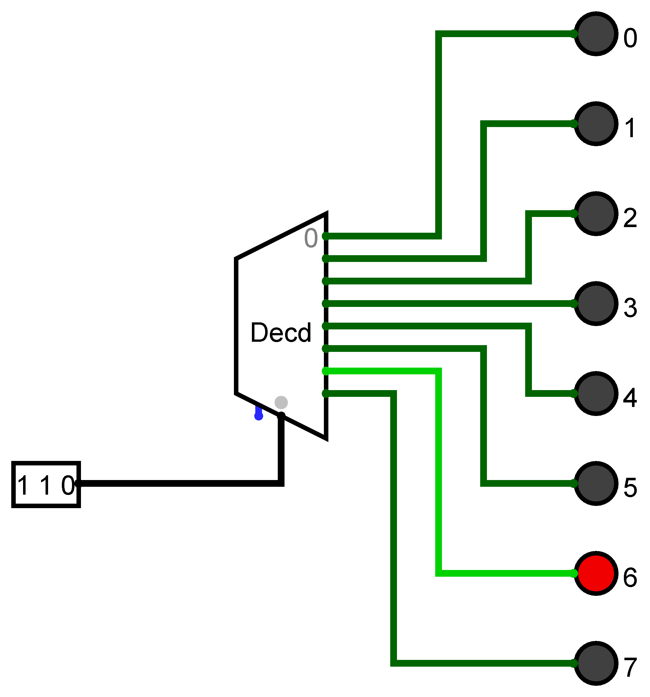
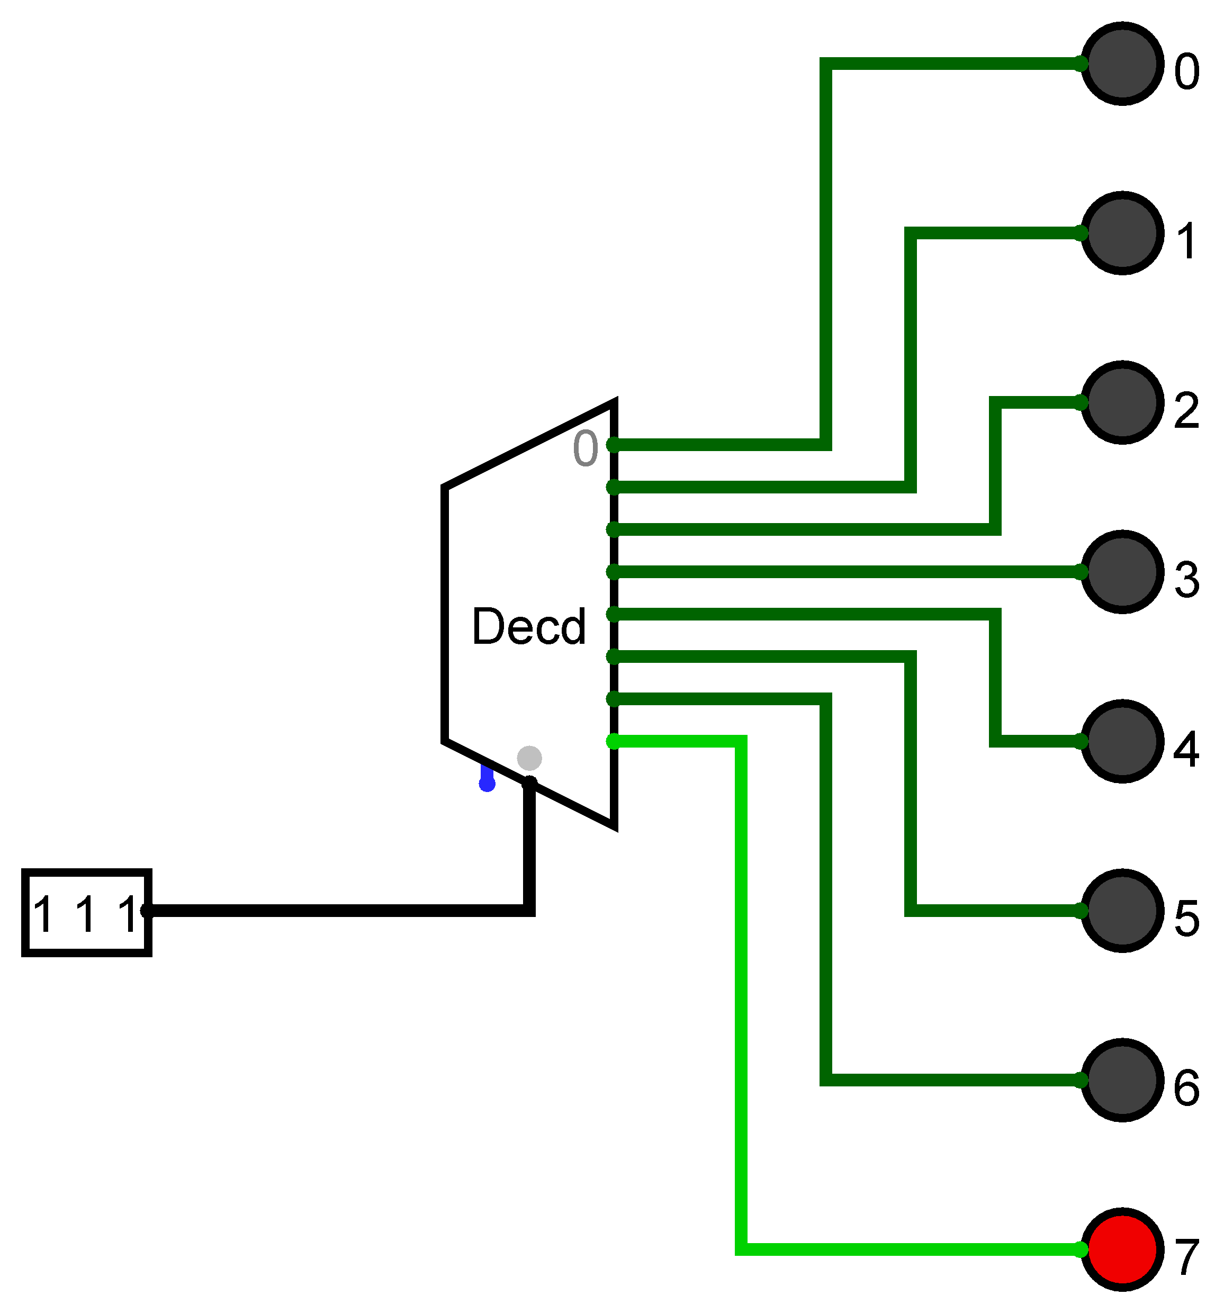
Decoder Example
A 3-bit decoder using the built-in decoder component in Logisim

Slide 6
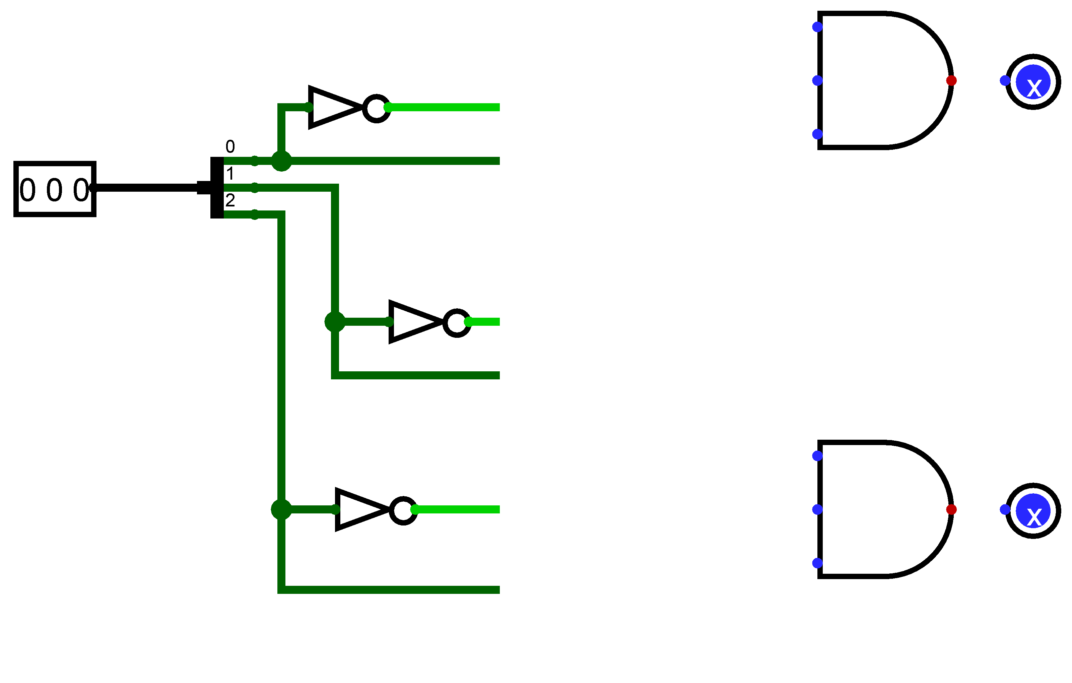
Creating a decoder
Starting to create a 3-bit decoder
Input signal is split into separate bits
Each bit is available inverted
Each output will need an AND gate, note that the AND gates have three inputs
Only the first two outputs are shown (of the 8 needed)

Slide 7
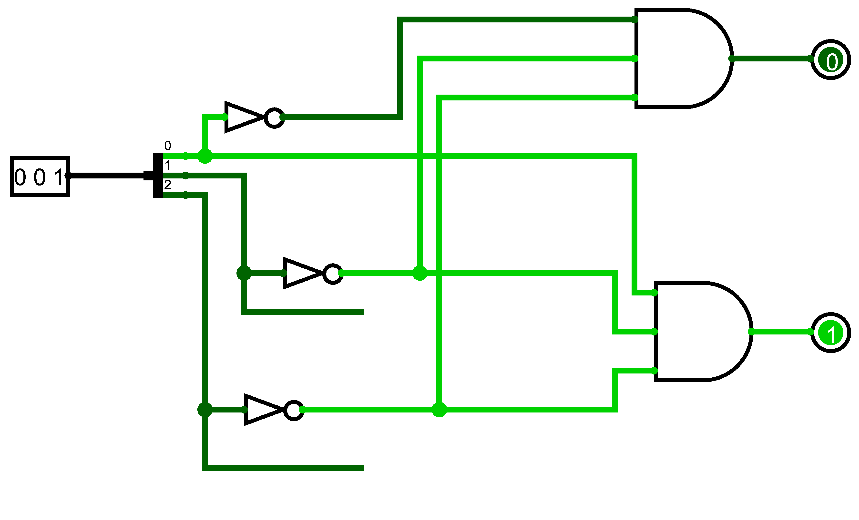
Creating a decoder
Starting to connect the outputs
The first one, representing zero needs all three input bits to be 0.
That is the same as the inverse of each bit being a 1.
The three input bits are passed through NOT gates before going to the AND gate.

Slide 8
Demultiplexer
A demultiplexer uses the ideas of a decoder in that it takes in a binary signal that is decoded to separate outputs
In this case it will be known as a select signal to specify which output to use
The difference is that a demultiplexer passes on a data signal to the relevant output

Slide 9
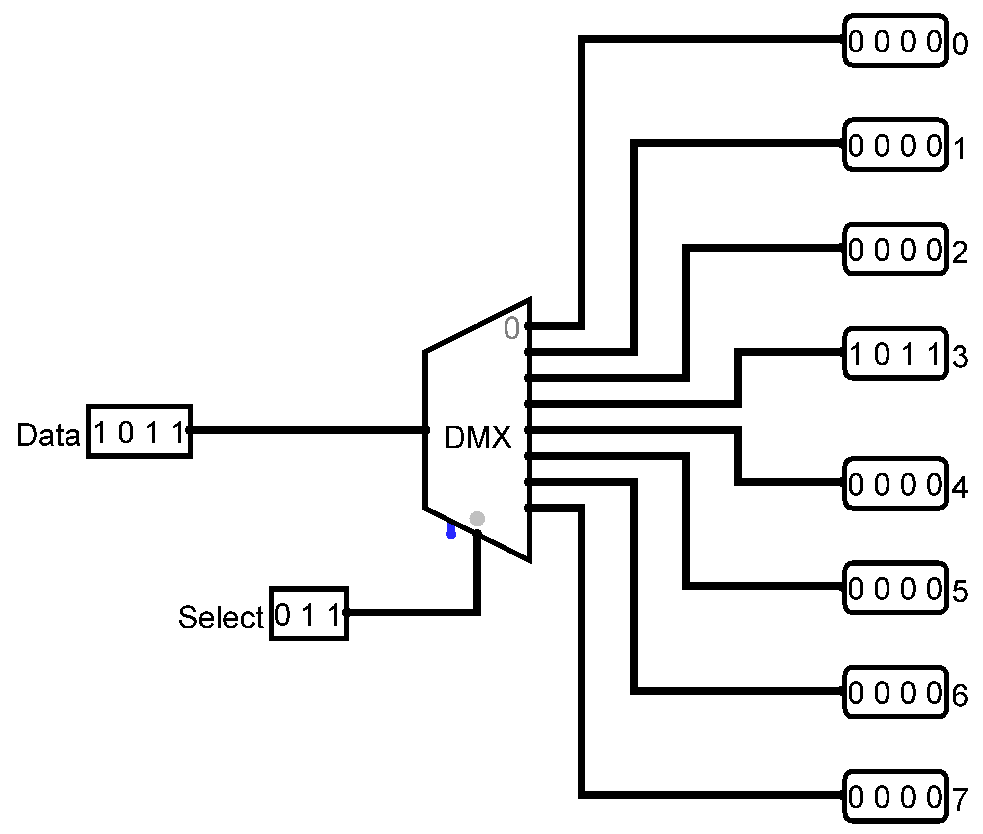
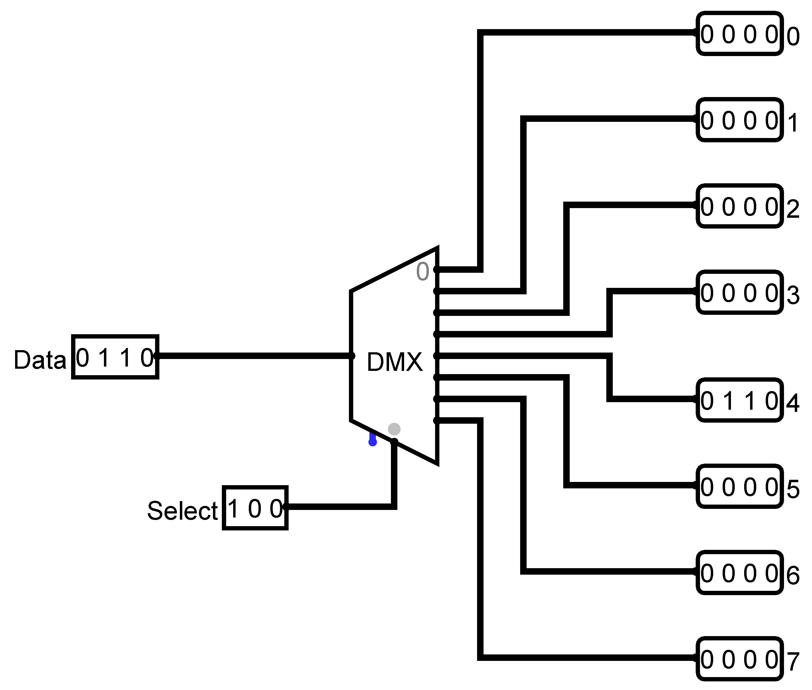
Demultiplexer example
The data signal is 4 bits and is passed to the output indicated by the select signal

Slide 10
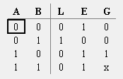
Comparator
A comparator compares two inputs (A and B)
It outputs a 1 on one of three outputs
E output is 1 if the inputs are Equal
L output is 1 if A is less than B
G output is 1 if A is greater than B
The other two outputs will be 0 in each case

Slide 11
1 Bit Comparator
A | B |  |  | L | E | G
0 | 0
0 | 1
1 | 0
1 | 1
1
1
0
1
0
1
0
1
0
0
In a 1-bit comparator A and B are 1-bit inputs
There are four possibilities
A is 0 and B is 0
The E (equal) output needs to be 1 because A and B are equal
A is 0 and B is 1
The L output needs to be 1 because A is less than B
A is 1 and B is 0
The G output needs to be 1 because A is greater than B
A is 1 and B is 1
The E (equal) output needs to be 1
0
1
0
0
1
0
0
0
1
0

Slide 12
1 Bit Comparator
A | B |  |  | L | E | G
0 | 0
0 | 1
1 | 0
1 | 1
1
1
0
1
0
1
0
1
0
0
Constructing a 1-bit comparator
Looking at the possibilities
A is 0 and B is 0 or A is 1 and B is 1
An XOR gate can check whether two inputs are the different – invert the output with a NOT gate to check if two inputs are the same
A is 0 and B is 1
This is the same as NOT A AND B
A is 1 and B is 0
This is the same as A AND NOT B
0
1
0
0
1
0
0
0
1
0

Slide 13
Comparing multiple bits
A1 | A0 | B1 | B0 | L | E | G
0 | 0 | 0 | 0
0 | 0 | 0 | 1
0 | 0 | 1 | 0
0 | 0 | 1 | 1
0 | 1 | 0 | 0
0 | 1 | 0 | 1
0 | 1 | 1 | 0
0 | 1 | 1 | 1
1 | 0 | 0 | 0
1 | 0 | 0 | 1
1 | 0 | 1 | 0
1 | 0 | 1 | 1
1 | 1 | 0 | 0
1 | 1 | 0 | 1
1 | 1 | 1 | 0
1 | 1 | 1 | 1
1
1
1
Consider a comparator for 2-bit numbers
A1 and A0 represent the two bits for input A
A0 is the least significant digit
Likewise for input B
There are 16 combinations of inputs
It might be easier to consider the decimal equivalent values of 0 to 3
1
1
1
1
1
1
1
1
1
1
1
1
1

Slide 14
Summary
We have looked at components that will be useful in creating a computer and seen how those components may be built from logic gates.

